Slide 1
Load-Aware UPF Scaling and Performance Evaluation in a 5G Core
5G and Beyond Projects 2026 · IIT Gandhinagar
Questions
1. At what load does one UPF degrade?
2. Can a second UPF join at runtime, and can a controller decide when?
3. How much does it help, and what limits it?
Suthar Jainish Chandraprakash and Gomtesh
Notes:
One UPF carries all user traffic. We measure the load at which it degrades, add a second UPF at runtime with a small controller, and compare it with the default of a single UPF and with an always-on two-UPF upper bound.

Slide 2
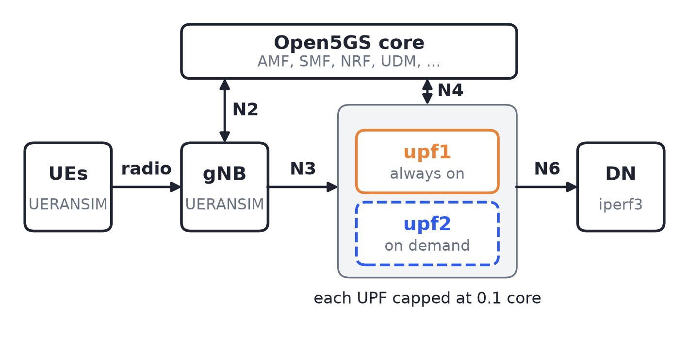
Test bed, and what we compare
Three set-ups
Default: 1 UPF, no scaling
Ours: a controller adds upf2 at 80% CPU
Upper bound: 2 UPFs always on
Same load for all: one new UE every 20 s, 12 Mbit/s each, up to 8. 3 runs each.
Measured: throughput, loss, RTT, UPF CPU and sessions.
Open5GS 2.8.0, UERANSIM 3.2.6, iperf3, Docker Compose. Each UPF has its own N3, N4 and N6 address.
Notes:
The cap makes the UPF saturate before the traffic generator does, so absolute Mbit/s are not real UPF capacities; the shape of the results is what matters. CPU and throttling are read through the Docker API, because a probe inside the UPF added 4% CPU at idle. The default is what Open5GS does out of the box: UPFs are listed statically in the SMF and nothing starts or stops one on load. The upper bound shows the best case for this load, with both UPFs up before any UE arrives.

Slide 3
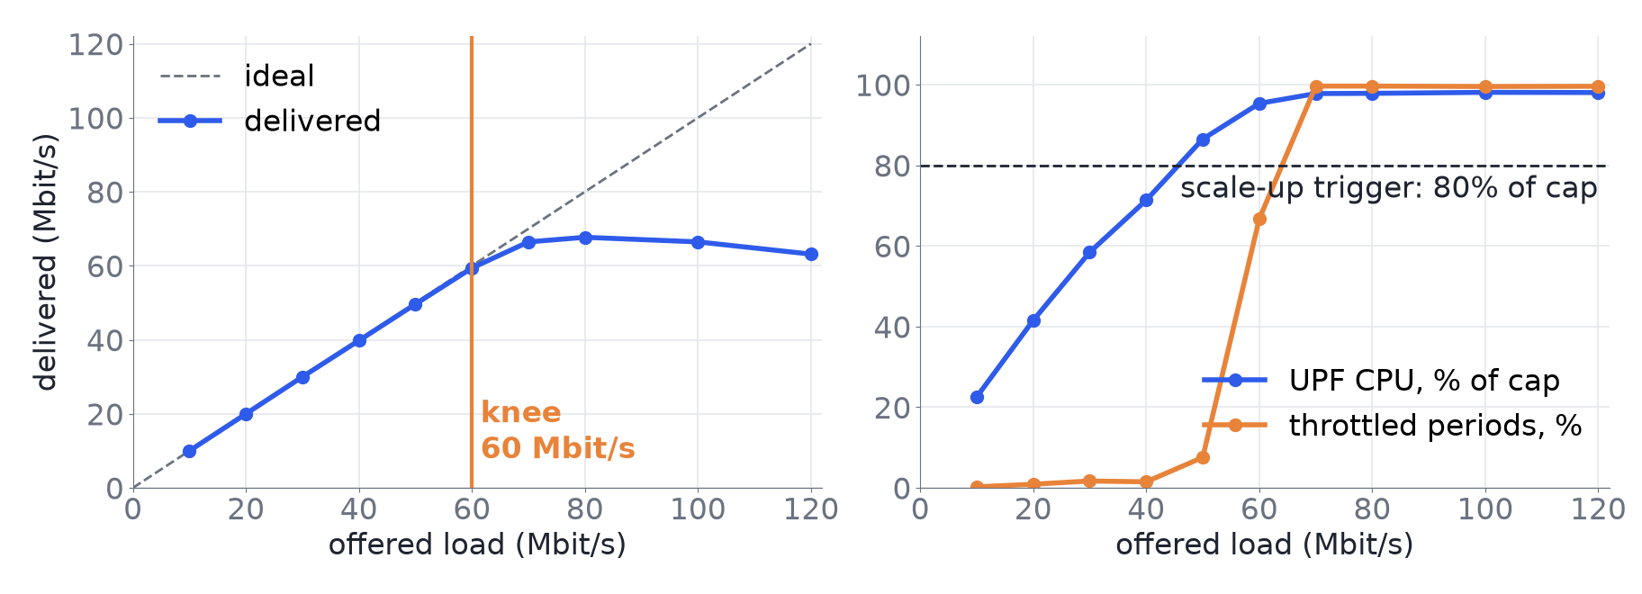
Problem: one UPF saturates near 68 Mbit/s
The default: one UPF, listed statically in the SMF, with nothing that scales it on load. Past 60 Mbit/s it runs out of CPU: throttling and RTT jump, then packets are lost.
4 UEs, 10 to 120 Mbit/s offered, 4 shuffled runs per load (medians, 40 of 40 runs valid). UPF capped at 0.1 core.
Notes:
Load sweep from 10 to 120 Mbit/s. At 60 Mbit/s, 67% of 10 ms periods are throttled and RTT p95 rises from 0.3 to 3.7 ms. Loss alone is a weak early signal, 1% at 60 Mbit/s, so a trigger based on CPU and throttling reacts earlier. The cap makes the UPF saturate before the traffic generator does, so absolute Mbit/s are not real UPF capacities; the shape matters. About 70 to 80% of the loss at high load happens inside the UPF.

Slide 4
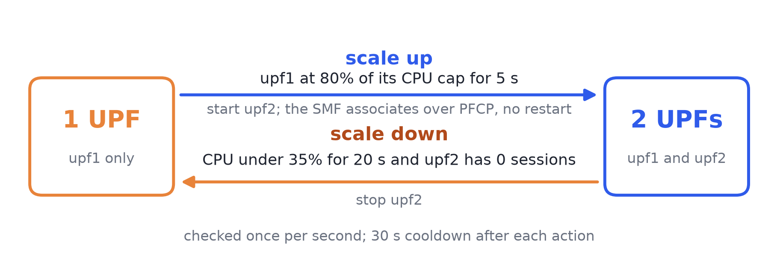
Solution: a controller starts a second UPF when the first reaches 80% CPU
upf2 has its own N3, N4 and N6 addresses and is already listed in the SMF. 80% of the cap is about 46 Mbit/s, three quarters of the knee, because a scale-up takes 5 s plus 3 to 7 s and only helps new sessions.
Notes:
The SMF lists both UPFs from the start and retries the PFCP association with the absent one about every 11 s, so upf2 is used as soon as it answers and the core is never restarted. The controller reads UPF CPU and throttling once per second through the Docker API. The 80% threshold is a design choice derived from the sweep; it was not itself swept. Both UPFs serve one UE pool, so the data network needs NAT on N6.

Slide 5
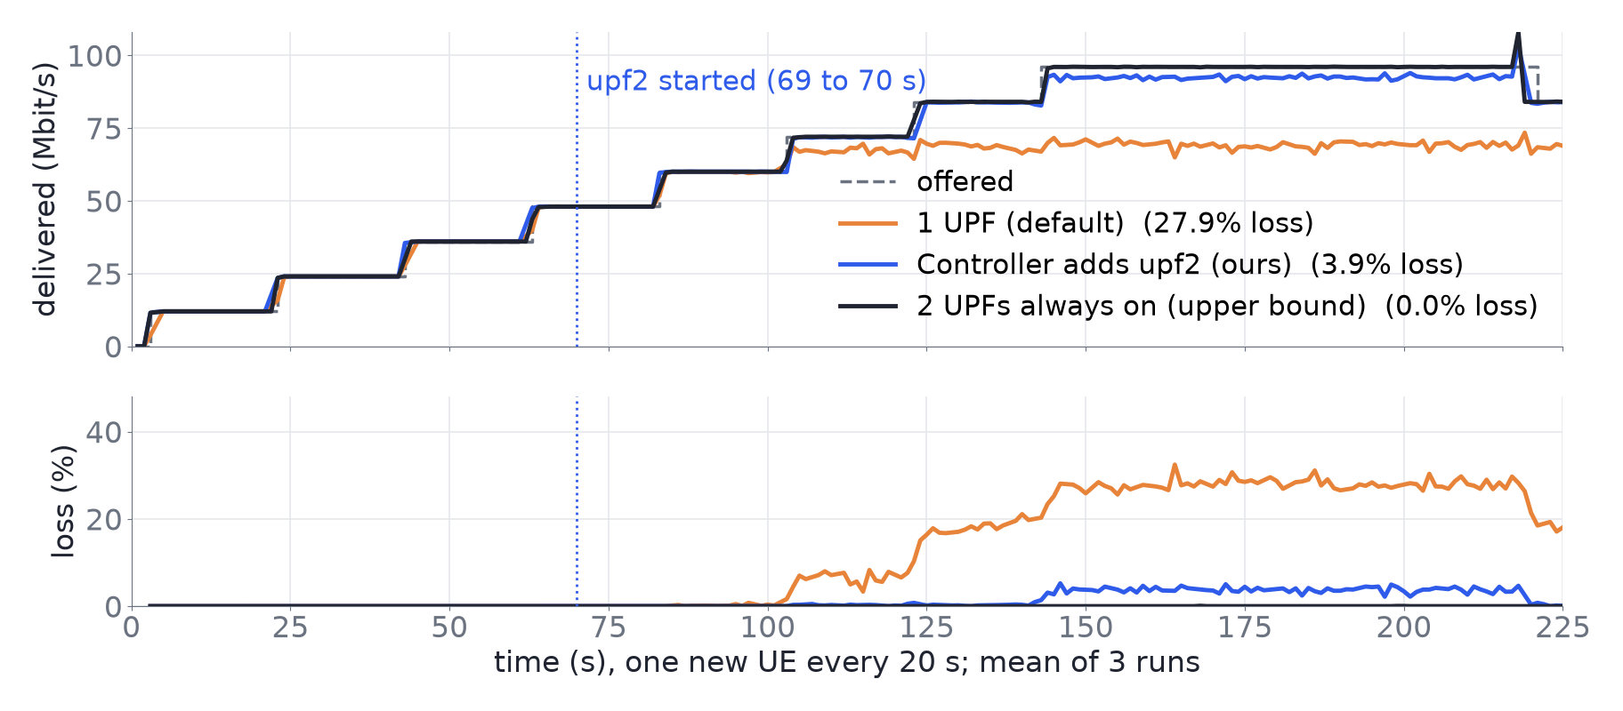
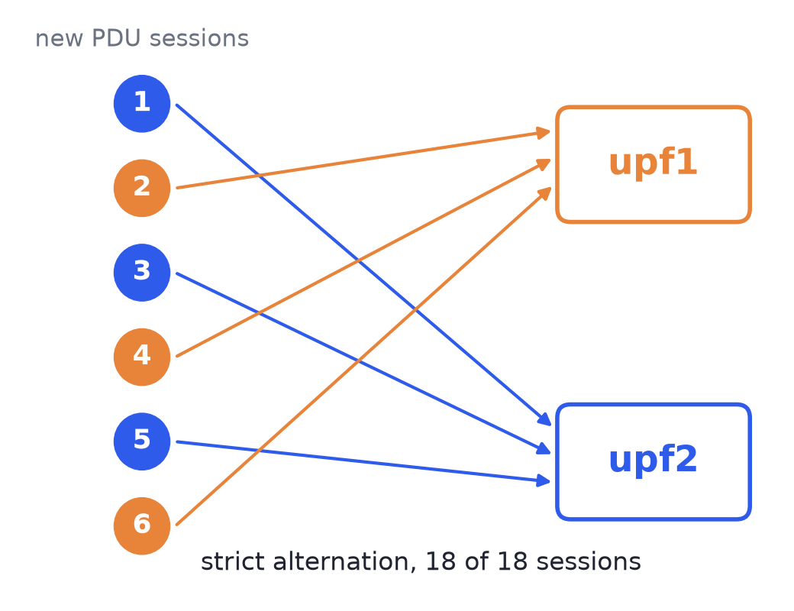
Scale up: loss at 96 Mbit/s offered falls from 27.9% to 3.9%
Why not 0.0%? The SMF alternates new sessions between the UPFs (18 of 18 in the N4 and N3 traces), so upf1 still gets every second new UE, and earlier sessions never move.
Compared: the default (1 UPF, no scaling), ours (controller adds upf2) and an upper bound (2 UPFs always on). One new UE every 20 s, 12 Mbit/s each, up to 8. Delivered 69.3 / 92.3 / 96.0 Mbit/s and RTT 8.7 / 3.7 / 0.8 ms. Mean of 3 runs; the ranges do not overlap.
Notes:
The controller fired at 69 to 70 s in all three runs, while the load was still below capacity. After that UEs 5 and 7 landed on upf2 and UEs 6 and 8 on upf1, so upf1 carried 6 UEs, 72 Mbit/s against about 68 capacity, which is roughly 4 Mbit/s lost out of 96. Traces: PFCP on N4 and GTP-U on N3, 3 runs of 6 new UEs; the GTP-U packets reached the UPF named in the PFCP Session Establishment. 86% less loss is (27.9 - 3.9) / 27.9.

Slide 6
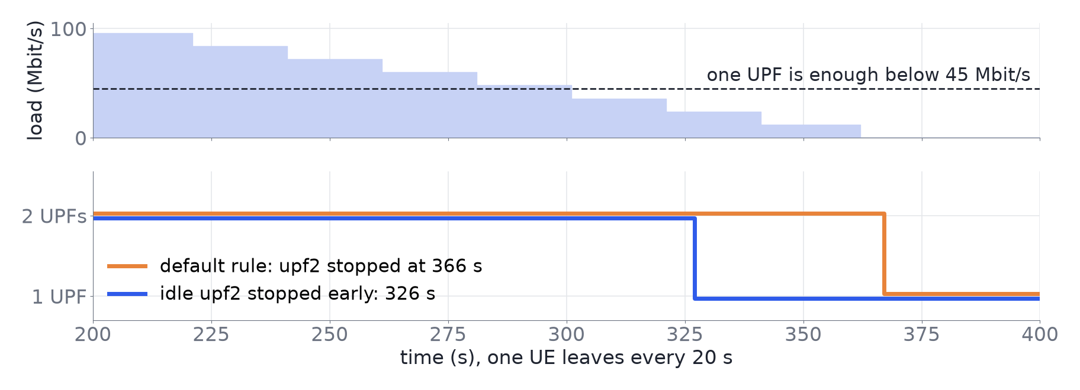
Scale down: waiting for upf2 to empty loses nothing; forcing the stop costs the UE about 11 s
12 of 12 ramp-downs lost no packets when the controller waited for 0 sessions.
40 s earlier when an idle upf2 is stopped early, at no cost.
10.7 s outage and a new IP if the stop is forced while a UE is on upf2.
One UE leaves every 20 s after 60 s at full load. Five variants, 3 runs each; 12 waited for 0 sessions, 3 were forced. Chart: one run.
Notes:
The SMF cannot be told to stop choosing a UPF, so stopping one with live sessions cuts them. Waiting for 0 sessions has no upper bound: one 12 Mbit/s UE kept upf2 running for 150 s after one UPF would have been enough. The early-stop option stops an idle upf2 once it has been empty for 20 s while upf1 alone is under the 80% limit.

Slide 7
Problems faced and what we did
Problem
What we did
A probe inside the UPF distorted its own CPU: 4% at idle
Read all stats from outside, through the Docker API
The traffic generator could not saturate a full-speed UPF
Capped each UPF at 0.1 CPU core
Hung iperf3 clients and dead UE tunnels corrupted early sweeps
Reset iperf3 every step, retried failed steps, flagged invalid runs
Open5GS is round-robin, never moves a session and cannot drain a UPF
Scale down only at 0 sessions; showed the forced stop as the costly option
How many Mbit/s fit in the cap depends on the host
Thresholds as a share of the cap, all numbers from one session
Result: no core restart, and 86% less loss at 96 Mbit/s.
Limits: the cap is artificial, uplink UDP only, one host, 3 runs per set-up; the 80% threshold was chosen, not swept.
Notes:
Other things that went wrong: UERANSIM radio links drop under stress, and one repetition was discarded after other applications exhausted the host's memory, so final measurements ran on a quiet host. Next steps: re-establish some PDU sessions after a scale-up, and load-aware UPF selection in the SMF.

